Slide 1
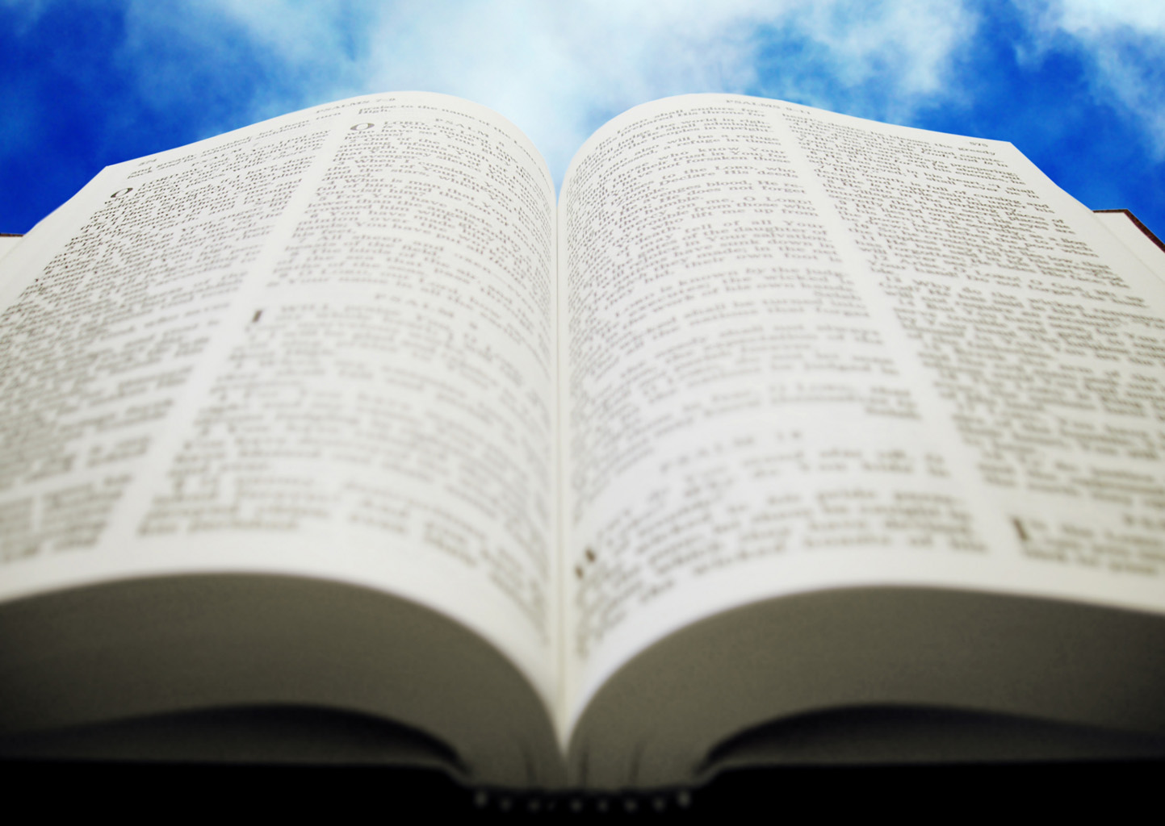
Welcome!
Sunday
Bible Study 9:30 AM
Worship 10:30 AM
PM Bible Class (Livestream) 5:00 PM
Wednesday
Bible Class 7:00 PM
www.SunsetchurchofChrist.net

Slide 2
John 1:1
The Word of God
Contrast with:
Genesis 1:1
Hebrews 1:1

Slide 3
John 1:1-5
Jesus:
The Word of God
The Creator of all things (Heb. 1:1-2)
Life
The Light of the World

Slide 4
John 1:6-8, 15
John the Baptist:
To bear witness of the Light
“Bore witness”
“Testified”
“Confessed”

Slide 5
John 1:9-18
The True Light
Rejected by His own
Received by those born of God (3:3)
In the flesh:
(Unseen) Glory of the Father
“Only Begotten”

Slide 6
John 1:19-28
Who was John the Baptist?
Not the Christ
Not the Prophet (Deut. 18:18)
Not Elijah (Matthew 17:10-13?)

Slide 7
John 1:19-28
Who was John the Baptist?
Isaiah 40:3 – Voice in the Wilderness
Malachi 4:5-6 – Elijah

Slide 8
Welcome!
Sunday
Bible Study 9:30 AM
Worship 10:30 AM
PM Bible Class (Livestream) 5:00 PM
Wednesday
Bible Class 7:00 PM
www.SunsetchurchofChrist.net

Slide 9
Opening Prayer | Rob Wade
Song – 4 (s) | Grant Haines
Scripture Reading | Lamar McDonald
Song – 679 | Grant Haines
Song – 167 | Grant Haines
Lord’s Supper | Lamar McDonald
Song – 501 | Grant Haines
Collection Prayer | Lamar McDonald
Song – 500 | Grant Haines
Lesson | Brian Haines
Song – 325 | Grant Haines
Closing | Ryan Sollars

Slide 10
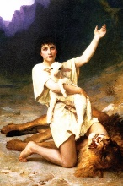
God raised up for them David as king, to whom also He gave testimony and said, 'I have found David the son of Jesse, a man after My own heart, who will do all My will.‘ Acts 13:22
Notes:
Ac 13:21 "And afterward they asked for a king; so God gave them Saul the son of Kish, a man of the tribe of Benjamin, for forty years. 22 "And when He had removed him, He raised up for them David as king, to whom also He gave testimony and said, 'I have found David the son of Jesse, a man after My own heart, who will do all My will.'23 "From this man's seed, according to the promise, God raised up for Israel a Savior--Jesus--

Slide 11
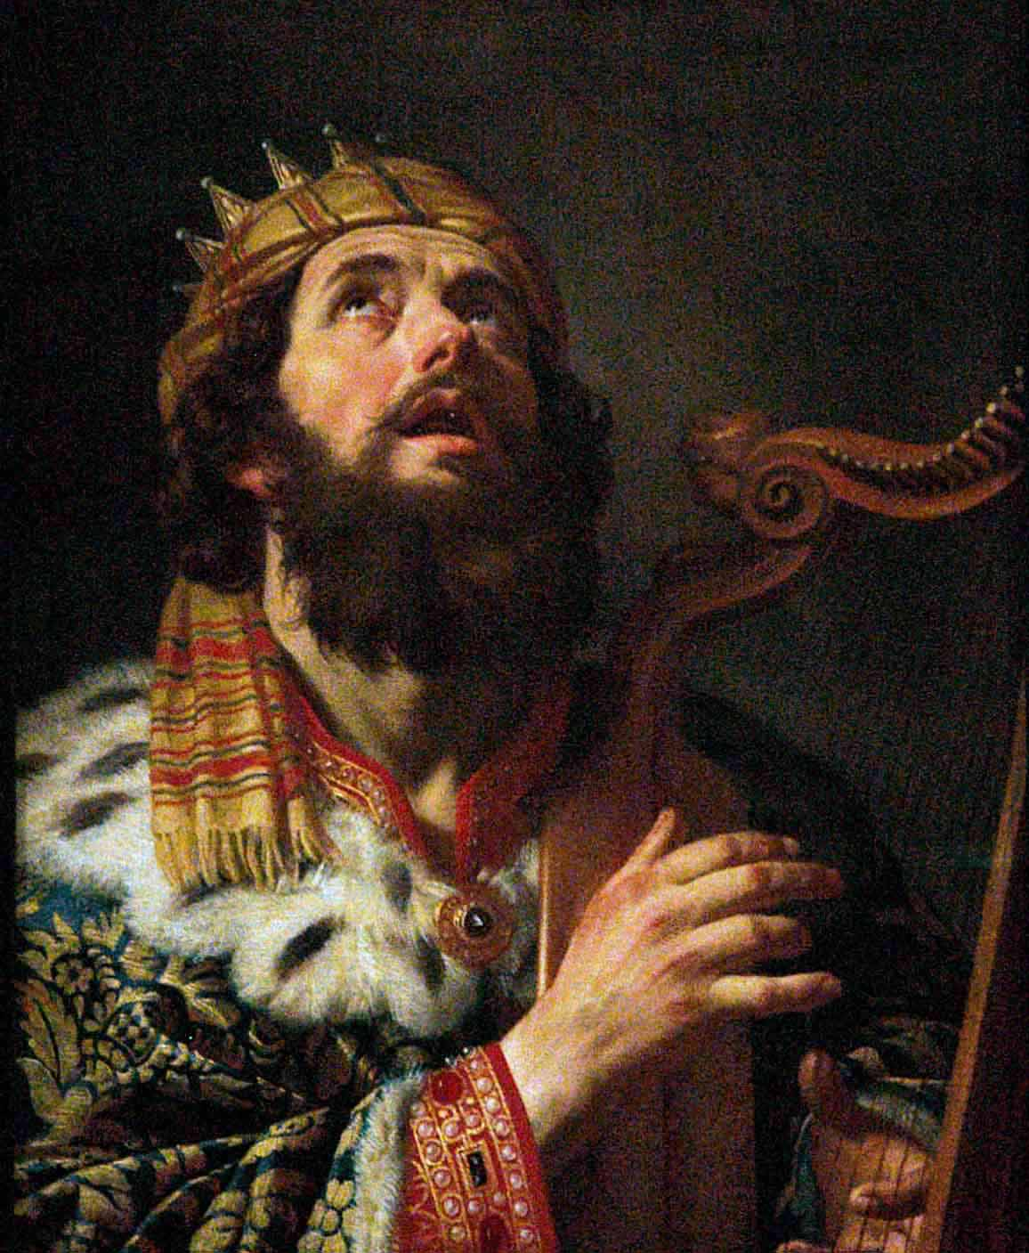
What Was Great About David?
He certainly had faults
Bathsheba
Numbering of Israel
We need to know why God loved him!

Slide 12
The Virtues of David
1. He REALLY trusted in God
1 Samuel 17:31-51

Slide 13
The Virtues of David
1. He REALLY trusted in God
2. He REALLY sought God’s advice
1 Samuel 23:2-4
2 Samuel 7:2-12
Notes:
1Sa 23:2 Therefore David inquired of the LORD, saying, "Shall I go and attack these Philistines?" And the LORD said to David, "Go and attack the Philistines, and save Keilah."
1Sa 23:4,6,9; 30:8; 2Sa 5:19,23
3 But David's men said to him, "Look, we are afraid here in Judah. How much more then if we go to Keilah against the armies of the Philistines?"
4 Then David inquired of the LORD once again. And the LORD answered him and said, "Arise, go down to Keilah. For I will deliver the Philistines into your hand."

Slide 14
The Virtues of David
1. He REALLY trusted in God
2. He REALLY sought God’s advice
3. He REALLY repented when he sinned
Psalm 51
1 Chronicles 21:13-26
Notes:
1Sa 23:2 Therefore David inquired of the LORD, saying, "Shall I go and attack these Philistines?" And the LORD said to David, "Go and attack the Philistines, and save Keilah."
1Sa 23:4,6,9; 30:8; 2Sa 5:19,23
3 But David's men said to him, "Look, we are afraid here in Judah. How much more then if we go to Keilah against the armies of the Philistines?"
4 Then David inquired of the LORD once again. And the LORD answered him and said, "Arise, go down to Keilah. For I will deliver the Philistines into your hand."

Slide 15
The Virtues of David
1. He REALLY trusted in God
2. He REALLY sought God’s advice
3. He REALLY repented when he sinned
4. He REALLY loved God’s law
Psalm 119
Notes:
1Sa 23:2 Therefore David inquired of the LORD, saying, "Shall I go and attack these Philistines?" And the LORD said to David, "Go and attack the Philistines, and save Keilah."
1Sa 23:4,6,9; 30:8; 2Sa 5:19,23
3 But David's men said to him, "Look, we are afraid here in Judah. How much more then if we go to Keilah against the armies of the Philistines?"
4 Then David inquired of the LORD once again. And the LORD answered him and said, "Arise, go down to Keilah. For I will deliver the Philistines into your hand."

Slide 16
Pursuing Godliness
Incline your ear, and come to Me. Hear, and your soul shall live; And I will make an everlasting covenant with you-The sure mercies of David Isaiah 55:3
Notes:
Ac 13:34 "And that He raised Him from the dead, no more to return to corruption, He has spoken thus: 'I will give you the sure mercies of David.'
Heb 12:14 Pursue peace with all people, and holiness, without which no one will see the Lord:

Slide 17
Pursuing Godliness
REALLY trust God – 1 Timothy 4:10
REALLY seek the Lord’s will – Romans 12:2
REALLY repent – 2 Corinthians 7:10
REALLY love the Law of Christ – John 14:15
Notes:
1Ti 4:10 For to this end we both labor and suffer reproach, because we trust in the living God, who is the Savior of all men, especially of those who believe.
Ro 12:2 And do not be conformed to this world, but be transformed by the renewing of your mind, that you may prove what is that good and acceptable and perfect will of God.
2Co 7:10 For godly sorrow produces repentance leading to salvation, not to be regretted; but the sorrow of the world produces death.
Joh 14:15 ¶ "If you love Me, keep My commandments.

Slide 19
Delight in the Will of God
I delight to do Your will, O my God,
And Your law is within my heart.
Psalm 40:8

Slide 20
Delight in the Will of God
I delight to do Your will, O my God,
And Your law is within my heart.
Psalm 40:8
For I delight in the law of God according to the inward man. Romans 7:22

Slide 21
Doing the Will of God
"For whoever does the will of God is My brother and My sister and mother.“ Mark 3:35

Slide 22
What is the Will of God?
To Hear Him and Believe
"Most assuredly, I say to you, he who hears My word and believes in Him who sent Me has everlasting life” John 5:24

Slide 23
What is the Will of God?
To Confess Him
"I say to you, whoever confesses Me before men, him the Son of Man also will confess before the angels of God.” Luke 12:8

Slide 24
What is the Will of God?
To Repent
"The time is fulfilled, and the kingdom of God is at hand. Repent, and believe in the gospel.“ Mark 1:15

Slide 25
What is the Will of God?
To Be Baptized
"He who believes and is baptized will be saved; but he who does not believe will be condemned.” Mark 16:16

Slide 26
What is the Will of God?
To Remain Faithful
Be faithful until death, and I will give you the crown of life. Revelation 2:10

